Slide 1



Task 2: Hotel Aggregator Analysis with Power BI
Name: Vishwanath Goud Kallem
Profile: Data Analyst Intern
Batch: MIP-DA-07

Slide 2
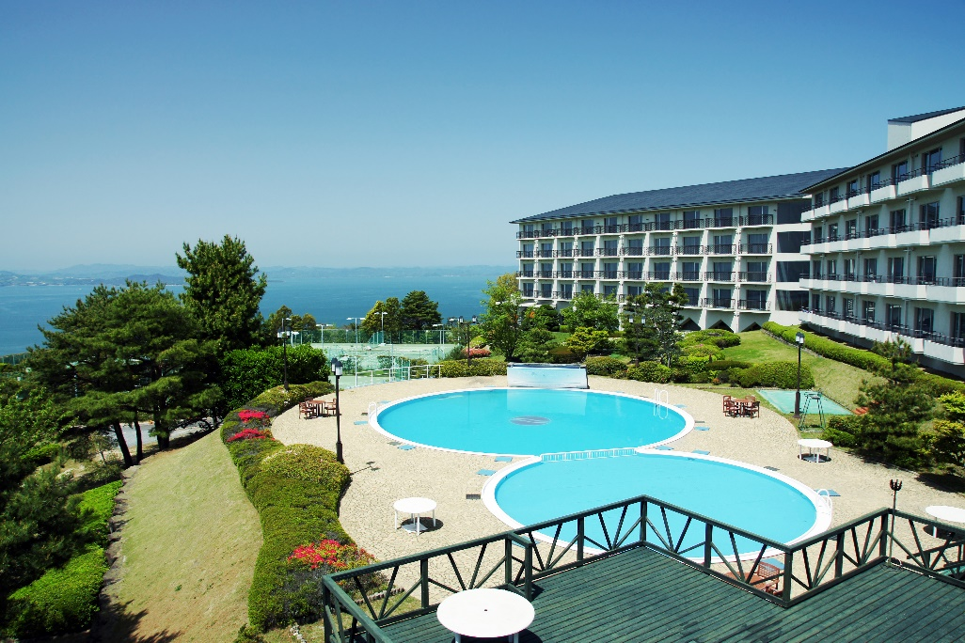
Project Overview
We will cover the experience of analysing a hotel aggregator dataset using Power BI.
Our exploration will include creating visualizations, identifying trends and patterns, and understanding the various factors that impact listing performance.
Ultimately, our aim is to extract actionable insights that can enhance the quality and competitiveness of listings.
This Photo by Unknown Author is licensed under CC BY-SA

Slide 3
Dataset Description
Description of each column in the dataset (Hotel Aggregator Dataset)
Id: unique identifier for each listing.
Listing_url: url of the listing on the hotel aggregator platform.
Scrape_id: identifier for the data scraping event.
Last_scraped: date of the last data scrape.
Source: source of the listing information.
Name: name of the listing.
Description: description of the listing.
Neighborhood_overview: overview of the neighborhood where the listing is located.
Picture_url: URL of the listing's picture.
Host_id: unique identifier for the host.
(And many more columns capturing details about hosts, location, property type, room details, amenities, pricing, availability, reviews, and other relevant information)

Slide 4

Data Visualization Tool Used
Microsoft Power BI

Slide 5
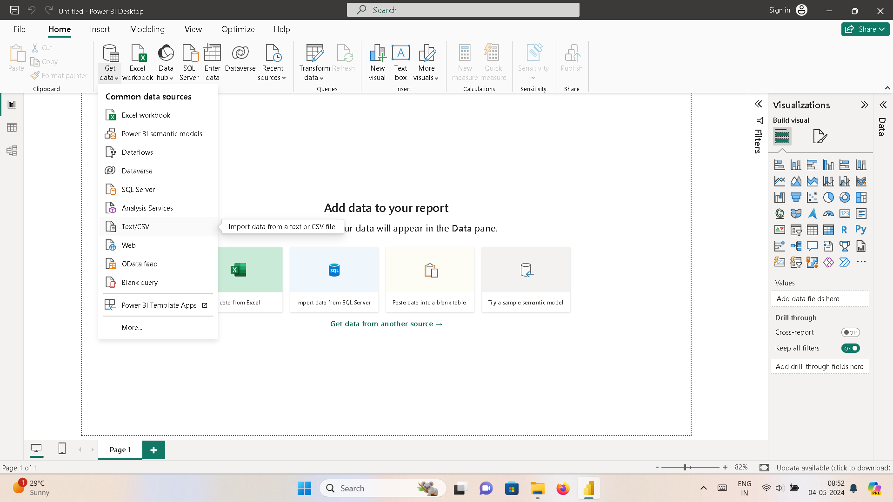
How to Import Data into Power BI ?
Click on get data & Select the file type and
“Import Data”

Slide 6
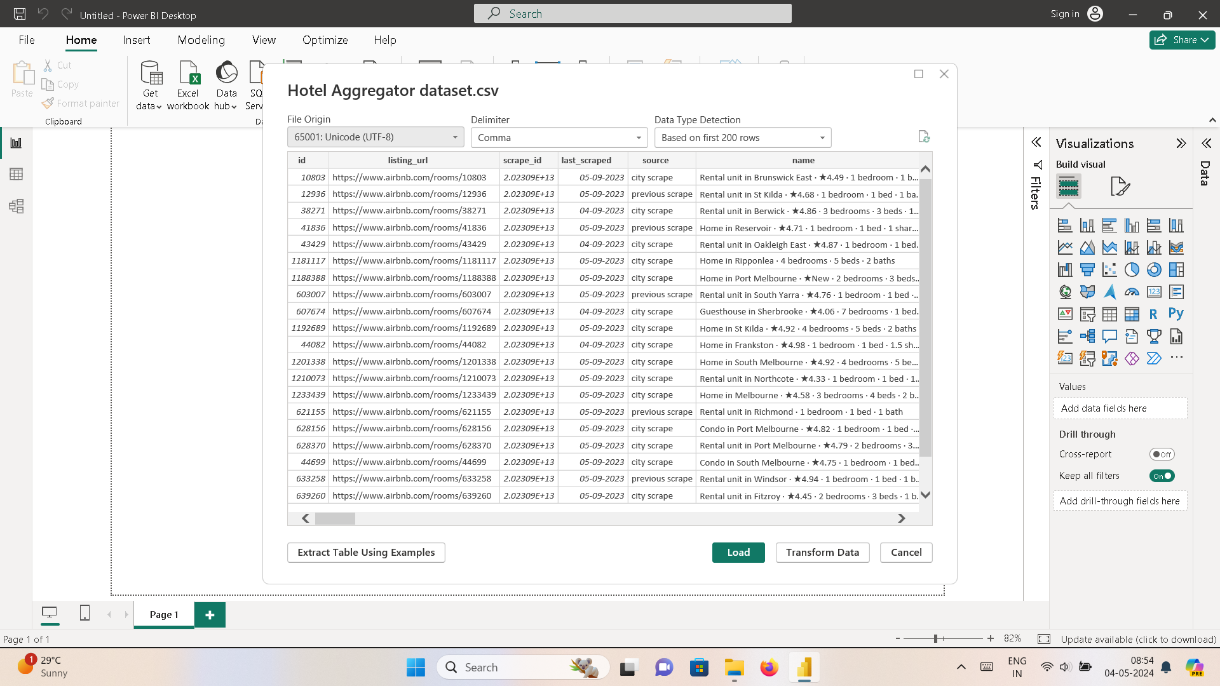
Transforming Data into Power Query Editor

Slide 7
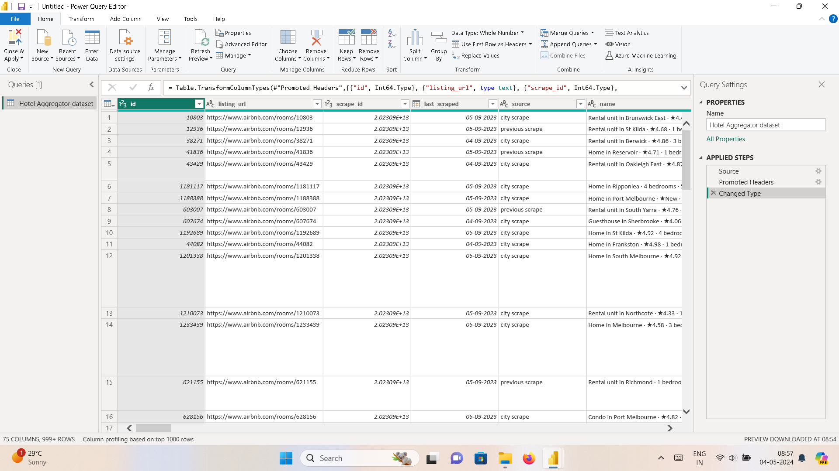
Imported Data into Power Query Editor

Slide 8

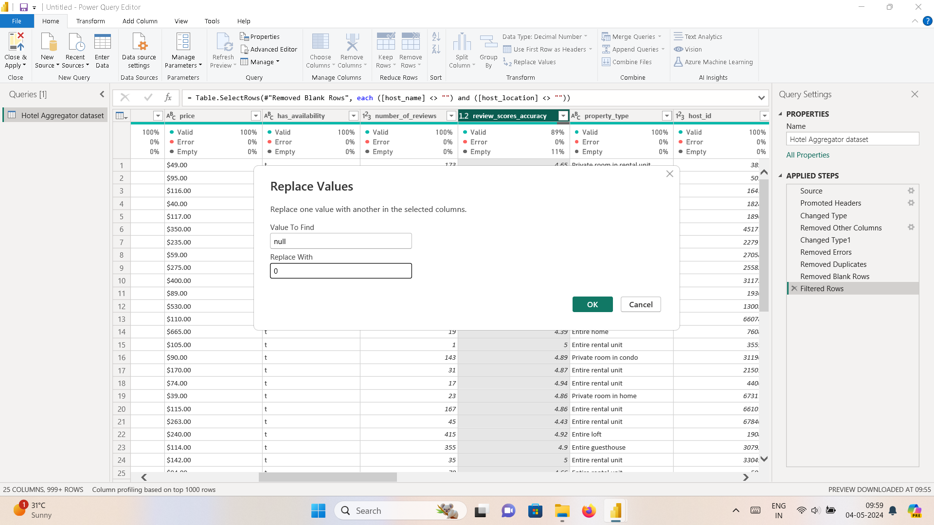
Data Cleaning in Power Query Editor

Slide 9
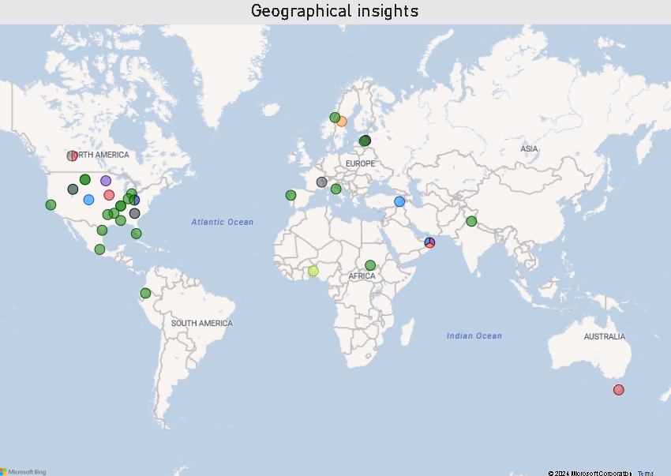
Geographical Insights
Australia stands out with the most popular locations, with central business districts emerging as the most popular neighborhoods.

Slide 10
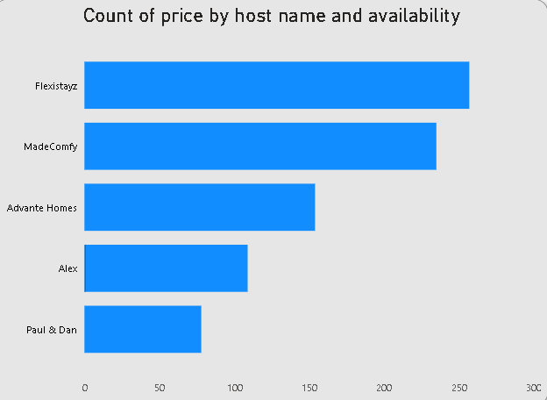
Pricing & Availability Analysis
Displaying the top five hosts alongside their prices and availability.

Slide 11
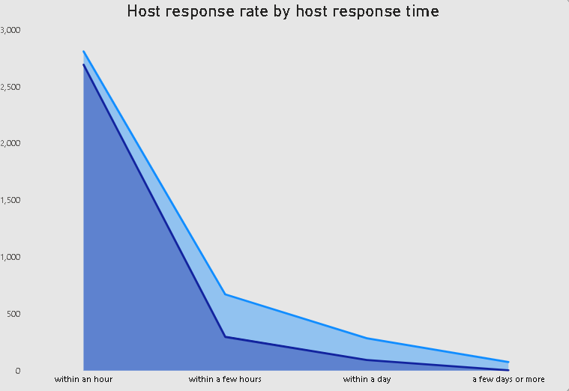
Host Performance
Highlighting response times, with the highest occurring within an hour, followed by responses within a few hours, within a day, and a few days or more.

Slide 12
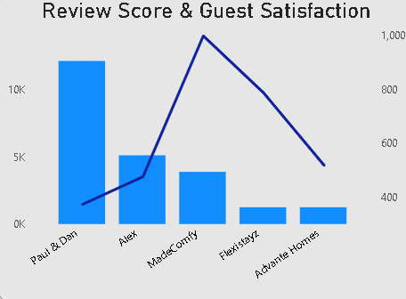
Review Scores & Guest Satisfaction
Presenting the top five review scores, review scores accuracy and guest satisfaction ratings.

Slide 13
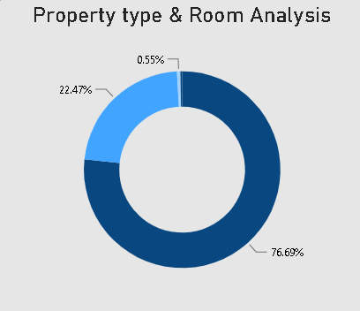
Property Type & Room Analysis
Displaying the distribution of property types and room types, with 76.69% for entire home/apartment, 22.47% for private rooms, 0.55% for shared rooms, and 0.3% for hotel rooms.

Slide 14
Insights
After analyzing the Hotel Aggregator dataset using Power BI, several insights have been uncovered:
Melbourne, Australia as Most popular Location with 20,866 listings.
Central Business district as most popular neighborhood with 7,147 listings.
Majority prefer entire homes/apartments (76.69%), indicating a desire for privacy and space.
Private rooms are popular (22.47%), appealing to solo travelers or those seeking intimacy.
Shared rooms (0.55%) and hotel rooms (0.3%) have limited demand, emphasizing preference for privacy and security.
Hosts can tailor listings to highlight privacy and amenities, focusing on popular accommodation types to attract bookings.
These insights offer valuable information on accommodation preferences and trends based on the provided dataset, informing hosts and property managers on how to optimize their listings to meet guest demands effectively.

Slide 15
Thank You!

